Slide 1
Impactful Listening
An Up Your Culture Workshop
Notes:
NOTES TO FACILITATOR:
Notes in bold are written to you. The rest can be used as a “script” if you like.
Some slides need to be viewed in slideshow mode.
Welcome to our Impactful Listening workshop from Up Your Culture.

Slide 2


Today we will:
1
Define Impactful Listening
Identify the Six Techniques of Impactful Listening
Participate in Listening-in-Action Exercises
Reflect on our current listening abilities and set goals
Notes:
Today we will be fun, interactive, and filled with information you can use right away.
We will:
Define Impactful Listening
Learn about the Six Levels of Impactful Listening
Participate in a listening-in-action exercise

Slide 3
Impactful Listening
Actively absorbing the information given to you by a speaker, showing that their voice is valued, and you are interested, and providing feedback that leads to growth.
Notes:
Before we begin, I’d like to hear how you would describe “Impactful Listening.”
If you are in a live meeting, call on a few people to share.
If you are in a virtual meeting, ask everyone to add a word or two to the chat that would describe Impactful Listening, and read a few aloud.
That was great input - thank you for sharing. This is a good starting point for this conversation.
[CLICK] Up Your Culture defines Impactful Listening as actively absorbing the information given to you by a speaker, showing that their voice is valued and you are interested, and providing feedback that leads to growth.
Share a few of your takeaways like:
1. Impactful listening shows someone that their voice is valued and leads them to grow.
2. It’s more than just “hearing” words; it involves understanding the full meaning of what is being said and communicating your understanding to the other person.
3. Whether someone is asking you questions, sharing information, or expressing needs or concerns, “Impactful Listening” can make a significant difference in how effective you are, and it greatly impacts our culture.
4. Anything else that stands out to you

Slide 4


“
v
When you talk, you are only repeating what you already know. But if you listen, you may learn something new.
– The Dalai Lama
Notes:
The Dalai Lama nailed the importance of impactful listening with this quote: “When you talk, you are only repeating what you already know. But if you listen, you may learn something new.”
Optional: encourage participants to comment on this and share their thoughts.
Let’s jump right into the concept of Impactful Listening.

Slide 5
Impactful Listeners
Create a “safe space”
Demonstrate focus
Ask questions and mirror to gain understanding
Recognize non-verbal cues
Challenge remarks with empathy
Provide meaningful feedback that leads to problem solving
Notes:
Great listeners tend to do 6 things to encourage information sharing and demonstrate they are listening. These techniques allow them to gather more information, provide better guidance and show others that they value their voice.
I’m going to share the Six Levels of Impactful Listening with you, and as we go through each one, I want you to make a note of them in your workbook and then give yourself a rating for each on a scale of 1-10. You will not need to share these ratings with anyone. These are just for you.
[CLICK] First, great listeners create the feeling of a “safe space” as they are listening to others. They do not make assumptions about what the person will share, and they are not judgmental. Once you write this down, make a note of how you would rate yourself here on a scale of 1-10, with ten high. Pause long enough for them to write this down and add a rating.
[CLICK] They also demonstrate focus by maintaining eye contact and using body language like nodding or leaning forward. They avoid multi-tasking by putting away their phone, exiting email, or even closing their door if they are in person. Write that down, and then add your personal rating. Pause long enough for them to write this down and add a rating.
[CLICK] Great listeners also ask questions that promote discovery and insight. Rather than only listening quietly, they ask questions when appropriate that let the speaker know they are tracking with them and want more information. They also mirror back what they have heard to ensure they understand. In essence, they create a two-way dialogue vs. one-way speech. Write this down and then rate yourself. Pause long enough for them to write this down and add a rating.
[CLICK] They are attentive to non-verbal cues, recognizing that the speaker’s body language is an accurate representation of their emotions. Pause long enough for them to write this down and add a rating.
[CLICK] They may challenge some of the remarks they hear but in a non-threatening way. In other words, while they may demonstrate that they value the opinion of the person talking to them by pushing back where appropriate and working to better track with them, they don’t come across as trying to win an argument. Pause long enough for them to write this down and add a rating.
[CLICK] Finally, great listeners find that sweet spot of providing meaningful feedback without necessarily solving the problem for the speaker. By asking questions and making valuable observations they help lead the speaker to solutions. Pause long enough for them to write this down and add a rating.

Slide 6
Those who listen well may reap both information and relational benefits that make them more influential.
-Journal of Research in Personalities
Notes:
Impactful listening is a win-win for you and for the person you are listening to.
It’s pretty obvious how it benefits the person speaking, but let’s consider how it benefits the listener. It has been proven that you have more ability to influence others by listening than by speaking.
How can listening make us more influential? Experts explain that if we listen carefully, we benefit from the information being shared with us, but we also gain valuable insight into the speaker, which allows us to better understand their objectives, beliefs, and attitudes. That bigger-picture understanding gives us what we need to influence them more effectively in the future.

Slide 7

How can you improve your listening?
Use the 6 Techniques of Impactful listening:
Ensure psychological safety
Demonstrate focus
Ask questions and mirror to gain understanding
Recognize non-verbal cues
Challenge remarks with empathy
Provide meaningful feedback that leads to problem solving
Notes:
Listening is a skill, and it requires development like any other skill.
Not every encounter requires all six levels of listening that I shared with you, but breaking it down in this way helps pinpoint areas of listening that may need skill development. Let’s explore each of these a bit more. You’ll see space in your workbook beginning to take notes.

Slide 8
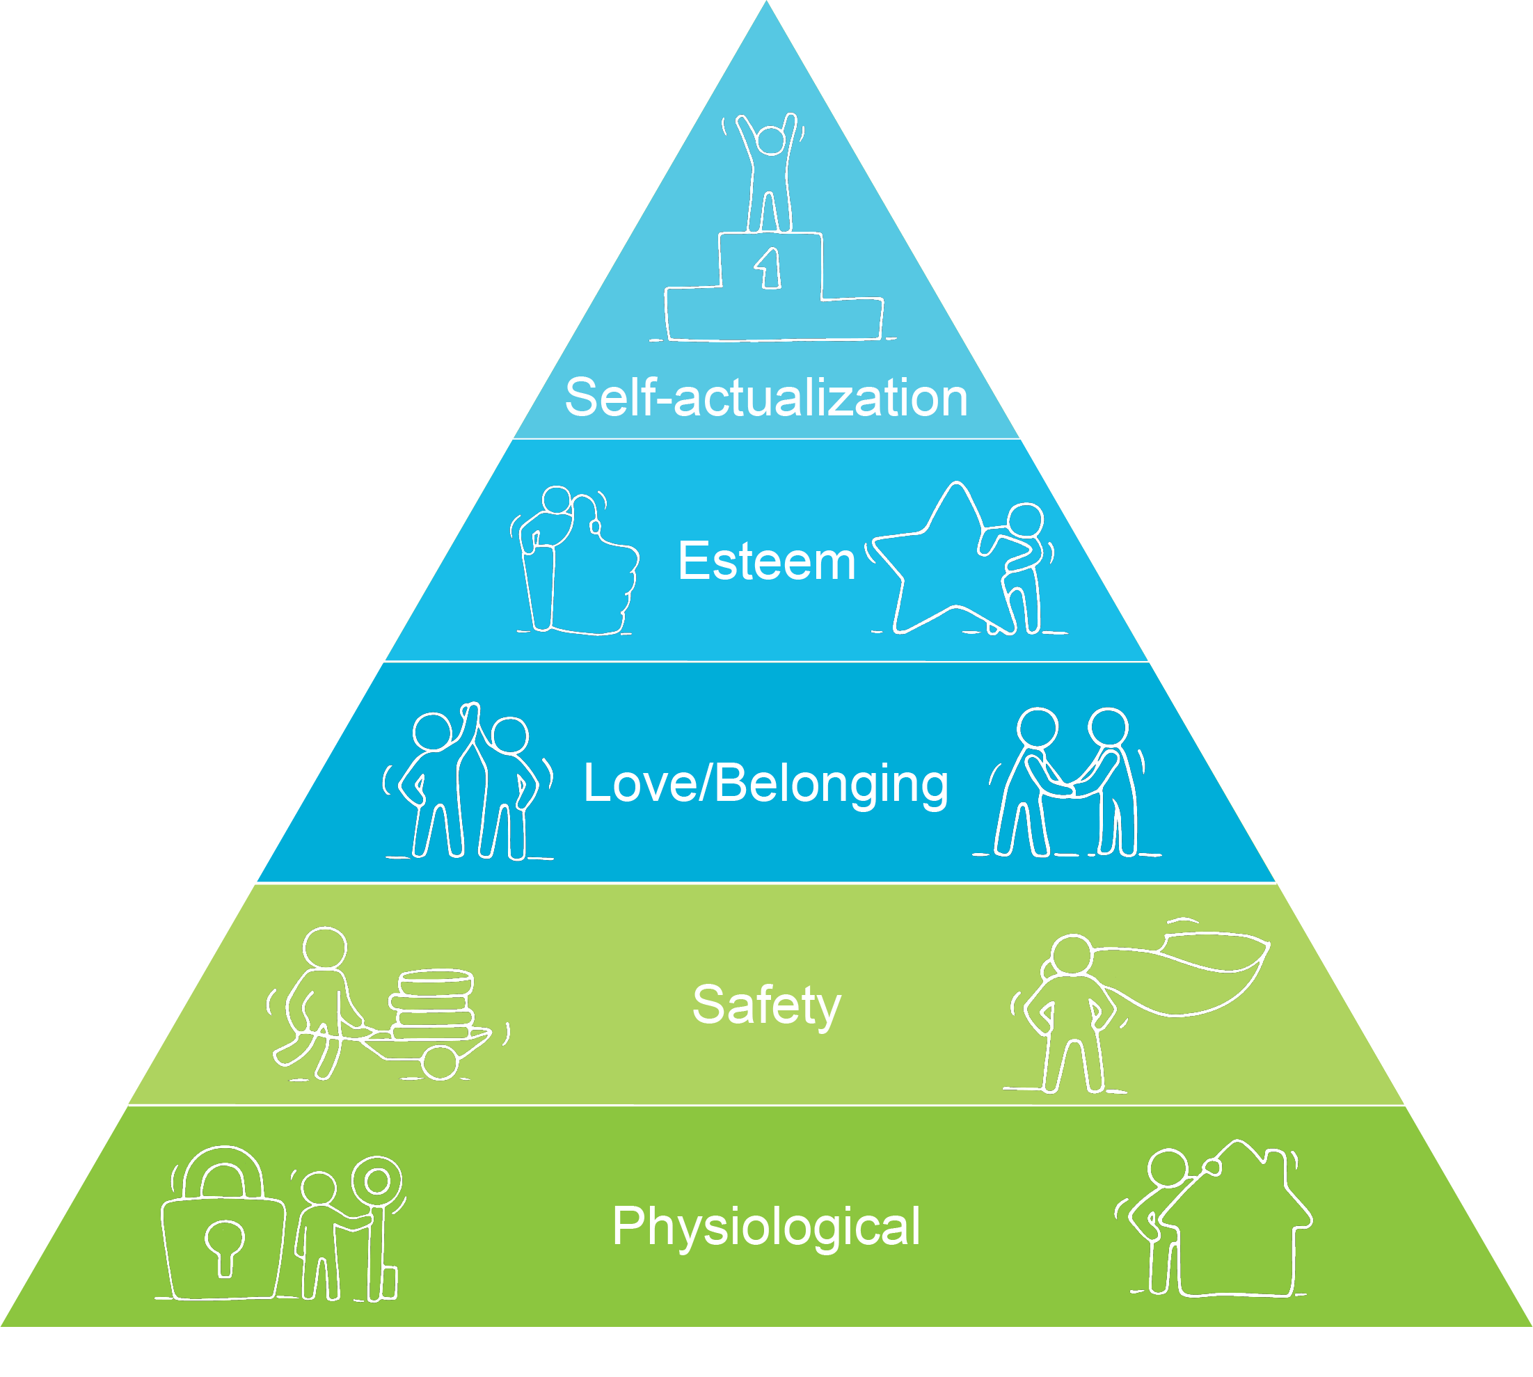
Level 1
Ensure Psychological Safety
Notes:
Level 1 is about creating a sense of safety for those who are speaking. You’ve probably heard this called creating a “safe space” or creating “psychological safety.”
Thinking about Maslow’s hierarchy of needs which you see on your screen, it’s about providing a safe environment so people feel supported where effective communication can happen. In a psychologically safe environment, it’s okay to speak your mind.
Look back at how you rated yourself here.
One best practice for creating a safe environment for someone you are speaking to involves reminding yourself that you are speaking human to human. The person you are talking with has beliefs, perspectives, and opinions, just like you; they have hopes, anxieties, and vulnerabilities, just like you, and they want to feel respected, appreciated, and competent, just like you.
What are some other ways you create a safe environment that encourages others to share?
Spend just a couple of minutes sharing and encourage them to capture notes.

Slide 9

Level 2
Demonstrate Focus
Notes:
Level 2 is about demonstrating focus. Look and see how you rated yourself here.
One of the best ways to do this is, before you begin listening, to eliminate distractions by silencing your phone and putting it away, closing email, and, if you’re meeting in person, turning away from your computer to resist the urge to look at it. That sets the stage and lets the person you are listening to know you are there to listen, even before you begin.
Also, don’t look at your watch or the clock, which can immediately make people feel as though they are taking up too much of your time. If necessary, suggest another place to talk without interruption. Focusing your attention on the speaker lets them know that what they have to say is important to you. Their voice is valued.
That may be a bit more difficult if you are on a virtual call. Remember to turn off distractions like email or cell phones. People can tell if you are texting or distracted, even when not face-to-face.
If you set aside 30 minutes for a conversation, make sure you spend those 30 minutes focused solely on what the other person needs from you. This will allow them to feel important and that they matter to you.
Ask if anyone has other suggestions to share.

Slide 10

Level 3
Ask Questions and Mirror to Gain Understanding
Notes:
Level 3 is about asking questions and mirroring the speaker to gain understanding. Impactful Listening is more than simply “not speaking” or shaking your head to give the impression you are listening. It’s about being present and engaged. You have to quiet the noise in your head, and if your mind wanders, actively bring it back to what is being shared.
I have 3 strategies to share here:
First, people who are very good at this avoid formulating a response while the speaker is talking. While it’s tempting to have a ready comment as soon as they pause, we need to challenge ourselves to devote all our energy to listening and then formulate a response as they conclude.
Second, make sure you understand the substance of what is being shared with you as well. Mirroring or reflecting to the speaker what you heard reinforces understanding. After the information has been shared, say something like, “If I’m understanding you correctly, you feel as though we should change our reporting process. Do I have that right?”
Third, remember you don’t need to solve everyone’s problems. Sometimes they just want to talk things through with you. Asking questions that lead to more details and information allows people to know they are understood.
Give them a moment to take notes.

Slide 11

Level 4
Recognize
non-verbal cues
80% of our communication is nonverbal
Notes:
Level 4 is about recognizing non-verbal cues.
To let others know you are actively listening, it is important to make eye contact, nod when appropriate, lean forward at times, and make comments like “I see” to show the speaker you are paying attention and tracking with them. This is equally effective for in-person and shared-screen meetings.
Non-verbal cues play a much larger role than you may realize - experts report that approximately 80% of our communication is nonverbal. So, challenge yourself while listening to remember how important your body language is to the success of your listening.
Encourage a short discussion or sharing if time permits.

Slide 12

Level 5
Challenge Remarks with Empathy
Their perspective
Feelings
Experiences
Notes:
Level 5 involves Empathy.
Impactful listeners pause before they challenge what someone is saying. First, they step out of their own shoes and step into the other person’s for a moment, considering:
their perspective
feelings
experiences
Even though you may be looking at the situation through a very different lens, take this time to understand them and how they will react.
What are some ways you can know about someone else’s perspectives, feelings, and experiences?
Generate brief discussion.

Slide 13

Level 6
Provide Meaningful Feedback that Leads to Problem Solving
Notes:
Finally, level 6. Provide Meaningful Feedback that leads to Problem Solving.
Although it may be instinctual to jump in to solve problems for people, and you may think that is your job, impactful listeners let people solve their own problems by talking through possible solutions. When people feel empowered to solve their own problems, they become more engaged and feel you trust them to make the right decision.
When you are sure you fully understand what they are asking of you, then contribute with questions.
Remember, it’s not always ideal to provide them with a solution. Instead, ask questions when appropriate to clarify the subtleties you are hearing and introduce other ideas for consideration. Make sure you are non-judgmental in your approach. By the time you reach this level of Impactful Listening, you have earned the ability to add your own insight and provide information the speaker may find useful.
Encourage brief closing thoughts.

Slide 14
Make Time
to Listen
“7 second rule”
Notes:
All six of these levels of Impactful listening are important but we know that listening and not speaking can be hard.
Sometimes silence will be required from you to really listen to someone, though. During Impactful Listening, silence improves concentration and focus. When you ask a question, allow the person you are speaking with to absorb, ponder, and process before they respond. Silence can be your friend. When you are quiet, you can learn more as the other person feels the need to fill the void of air space.
When meeting with people, we recommend allowing for 7 seconds of silence to let someone think or ponder an idea. We use the “7-second rule” because 5 seconds is likely to cut someone’s idea off, and 10 seconds can get to be too much silence.
This can vary whether you are meeting face-to-face or virtually. With virtual meetings, it can be harder to tell if someone needs more time to ponder an idea before they respond. The larger the group, the more time you may need to give. Those on the call may not want to talk first or talk over anyone, so they may wait a few seconds to see if someone will add to the conversation before they speak. Also, providing additional time may be necessary for them to share a thoughtful answer or add input to your conversation.
It may be difficult for some of you to allow for 7 seconds but give it a try and see what happens. Remember, the silence allows you time to truly understand what others are saying while giving them 7 seconds of silence to think of how to respond to you.
If they don’t respond in 7 seconds, consider asking your question in another way.
Silence can be a good thing when it’s used correctly.

Slide 15
Your Assignment:
Focus on your selected area of listening.
Notes:
Your assignment is to give one of these six areas a great deal of focus for the next few weeks. You need to decide which one you will focus on, so reflect back on the ratings you gave yourself on each one and consider which may need additional attention.
Optional: set a date/time to reconvene and share their progress in their area of focus.

Slide 16

Thank you

